Slide 1
Piezo-electric Transducer

Slide 2
Learning Outcomes
After the ending of the lesson, students will be able to know
The operating principle of piezoelectric transducer.
The equivalent circuit of a piezoelectric transducer.
The advantages and limitations of piezoelectric transducer.
Mathematical solution procedure of piezoelectric transducer

Slide 3
PIEZOELECTRIC EFFECT
There are certain materials that generate electric potential or voltage when mechanical strain is applied to them or conversely when the voltage is applied to them, they tend to change the dimensions along certain plane.
This effect is called as the PIEZOELECTRIC EFFECT.
This effect was discovered in the year 1880 by Pierre and Jacques Curie.
What do you mean by piezoelectric effect?

Slide 4
PIEZOELECTRIC TRANSDUCERS
The piezoelectric transducers work on the principle of PIEZOELECTRIC EFFECT.
When mechanical stress or forces are applied to some materials along certain planes, they produce electric voltage.
This electric voltage can be measured easily by the voltage measuring instruments, which can be used to measure the stress or force.
The voltage output obtained from the materials due to piezoelectric effect is very small and it has high impedance.
To measure the output some amplifiers, auxiliary circuit and the connecting cables are required.
Why piezoelectric transducer is called active transducer?
Why does piezoelectric transducer require amplifier?

Slide 5
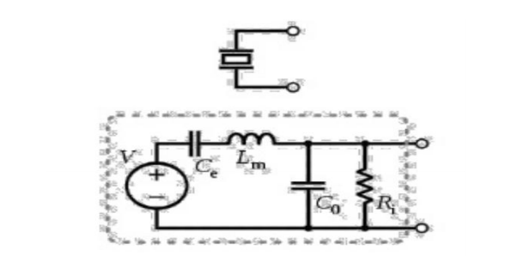
Circuit Diagram of Piezoelectric Crystal

Slide 6
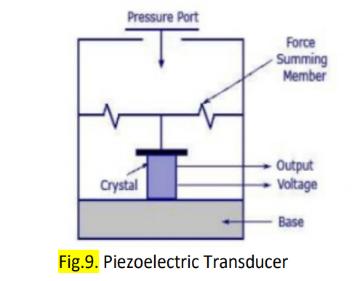
Working Principle of Piezoelectric Crystal
The figure shows a conventional piezoelectric transducer with a piezoelectric crystal inserted between a solid base and the force summing member.
If a force is applied on the pressure port, the same force will fall on the force summing member.
Thus a potential difference will be generated on the crystal due to its property.
The voltage produced will be proportional to the magnitude of the applied force

Slide 7
Math Problem
Q.1. A PET is directly connected to a voltmeter via a cable. The minimum operating frequency of this measurement is 1000 Hz. If the connecting cable length is double, what will be the new measurement frequency?

Slide 8
Math Problem
Q.2. A PET having 50 Mpa full scale pressure. This sensor has a sensitivity of 100 mv/Mpa. If a sensor is subjected to a static pressure of 10 Mpa then what will be the output?

Slide 9
Math Problem
Q.3. A quartz crystal with piezoelectric properties has a diameter of 10 mm and a thickness of 2 mm. Its voltage sensitivity constant is 4500 Vm/N. If V0= 127.3 V, then what will be the applied pressure?

Slide 10
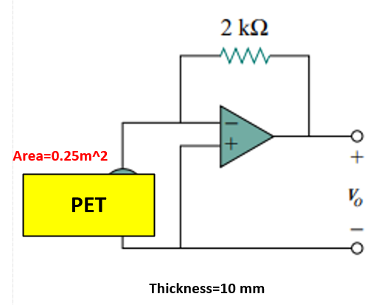
Math Problem
Q.4 . A piezoelectric crystal with voltage sensitivity of 100 Vm/N having Cp= 1600 pF and a leakage resistance of 10^12 ohm is connected to amplifier as shown below. If a force of 0.1 N, then what will be the output of this op-amp?

Slide 11
Advantages
High frequency response: They offer very high frequency response that means the parameter changing at very high speeds can be sensed easily.
High transient response: The piezoelectric transducers can detect the events of microseconds and also give the linear output.
Small size and Rugged Construction: The piezoelectric transducers are small in size and have rugged construction.

Slide 12
Disadvantages
Low Output: The output obtained from the piezoelectric transducers is low, so external electronic circuit has to be connected.
High impedance: The piezoelectric crystals have high impedance so they have to be connected to the amplifier and the auxiliary circuit, which have the potential to cause errors in measurement. To reduce these errors amplifiers high input impedance and long cables should be used.
Forming into shape: It is very difficult to give the desired shape to the crystals with sufficient strength.

Slide 13


